Slide 1
Segment Anything
Kirillov et al.
Meta AI Research
Presented by William Guimont-Martin
2024-02-21

Slide 2

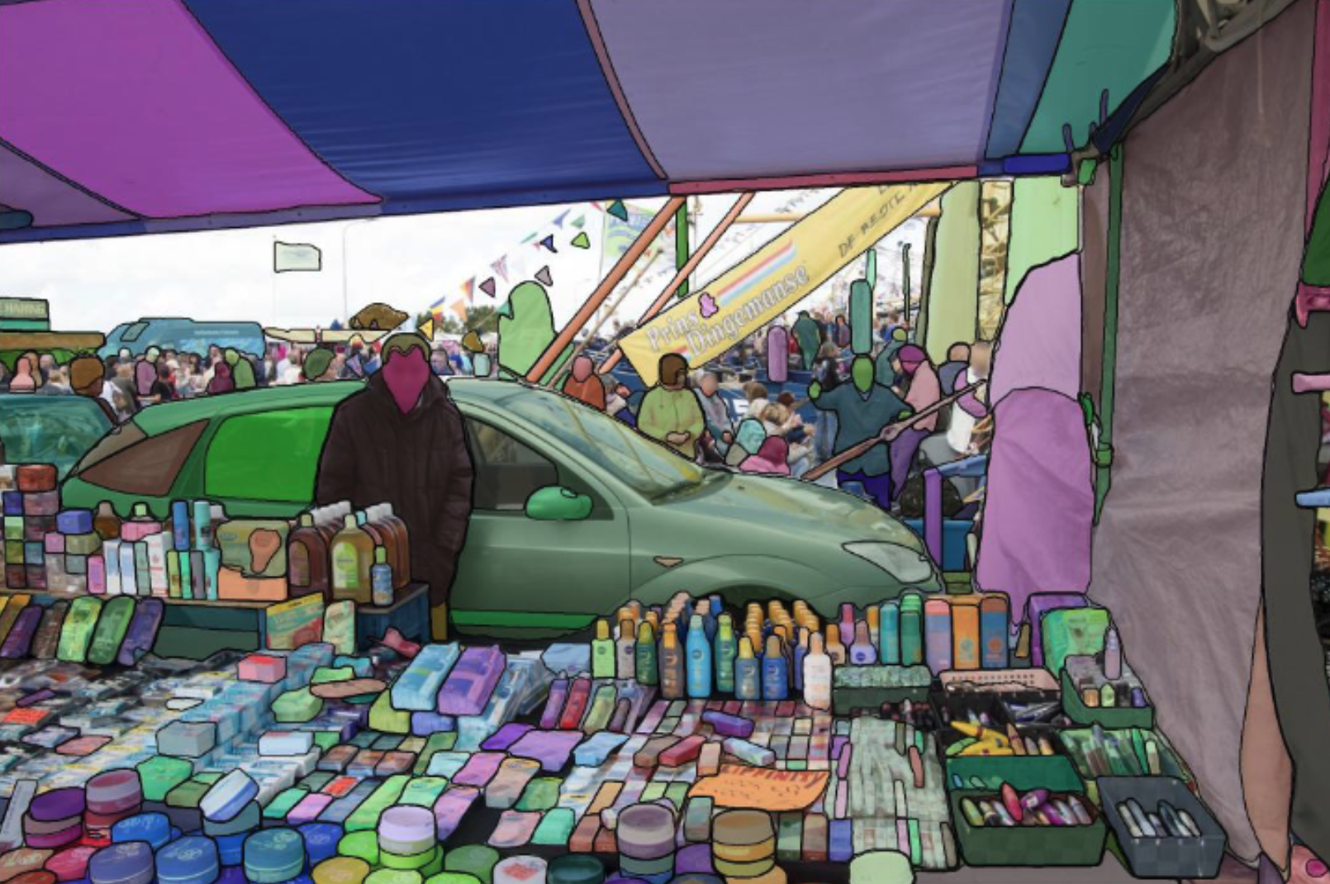
Segment Anything
Motivation
LLMs show strong zero- and few-shot generalization
New tasks using prompt engineering
Segment Anything as a vision foundation model for segmentation
Composable in a larger system to solve various tasks

Slide 3

Segment Anything
A small example

Slide 4
Segment Anything
Foundation model for image segmentation
What tasks will enable zero-shot generalization?
What is the corresponding model architecture?
What data can power this task and model?

Slide 5
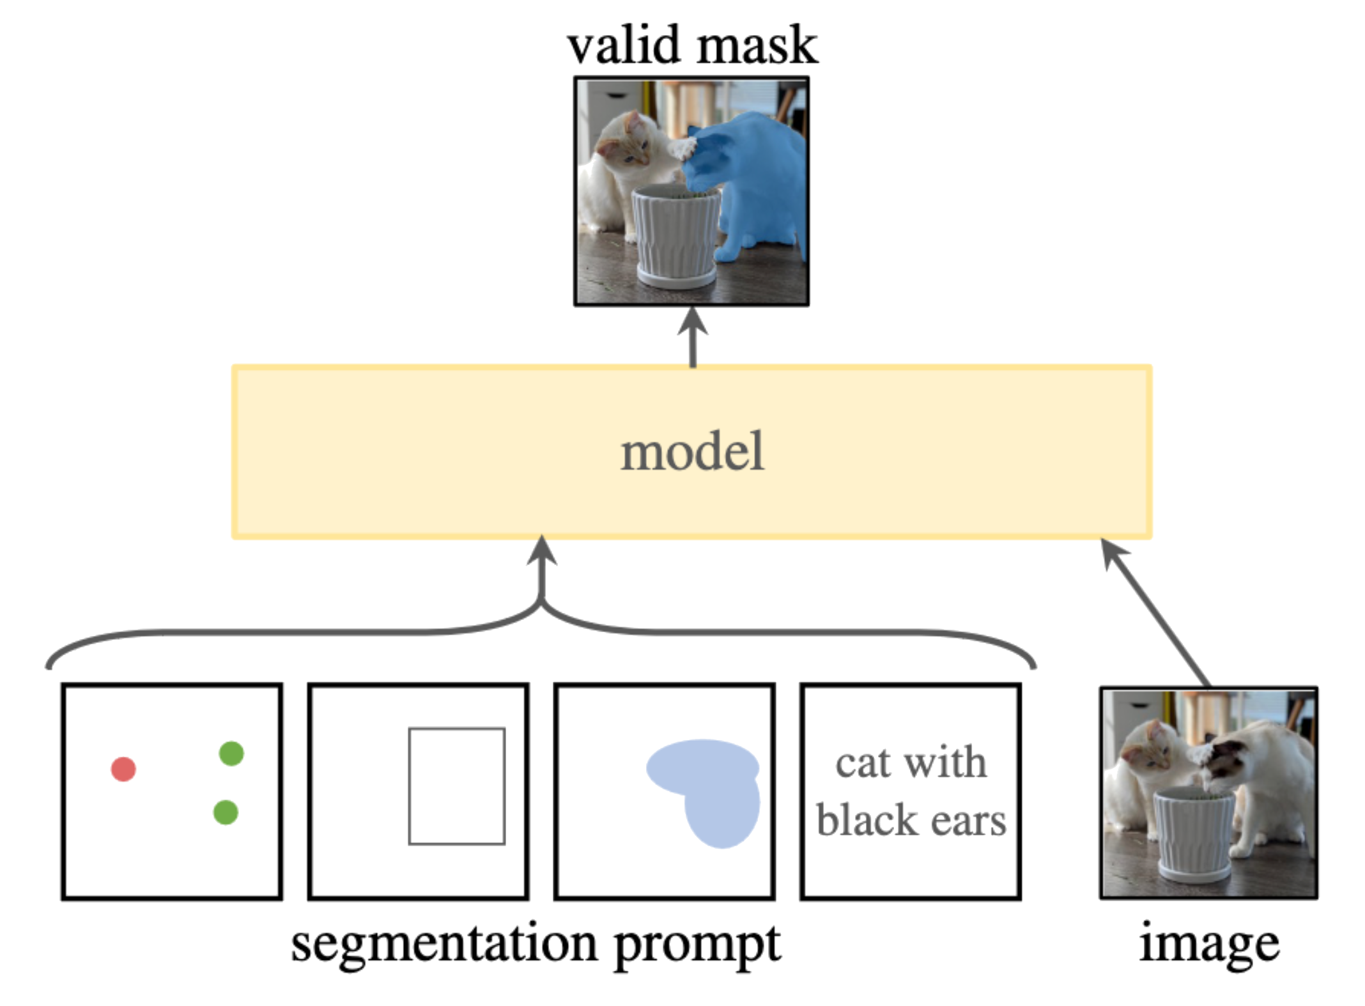
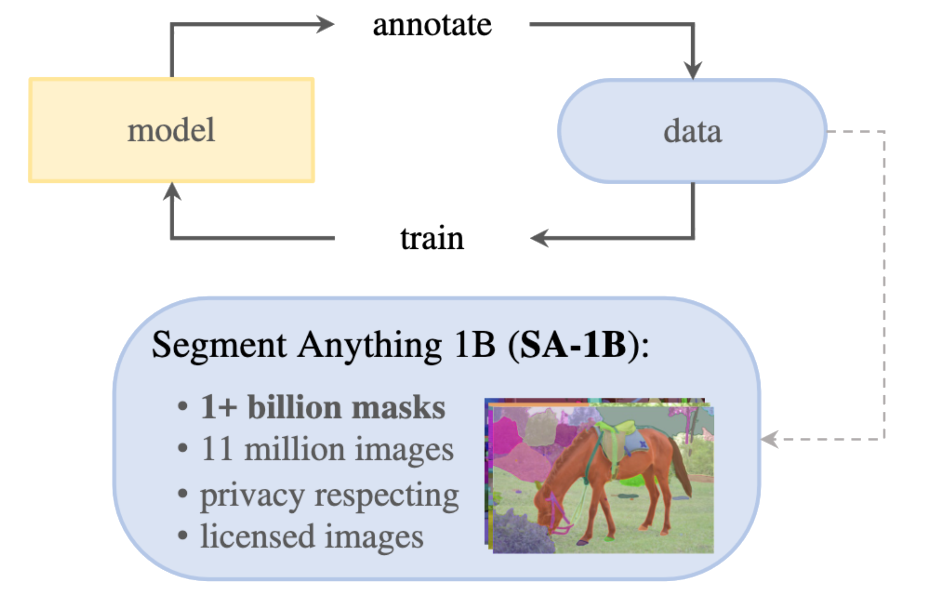
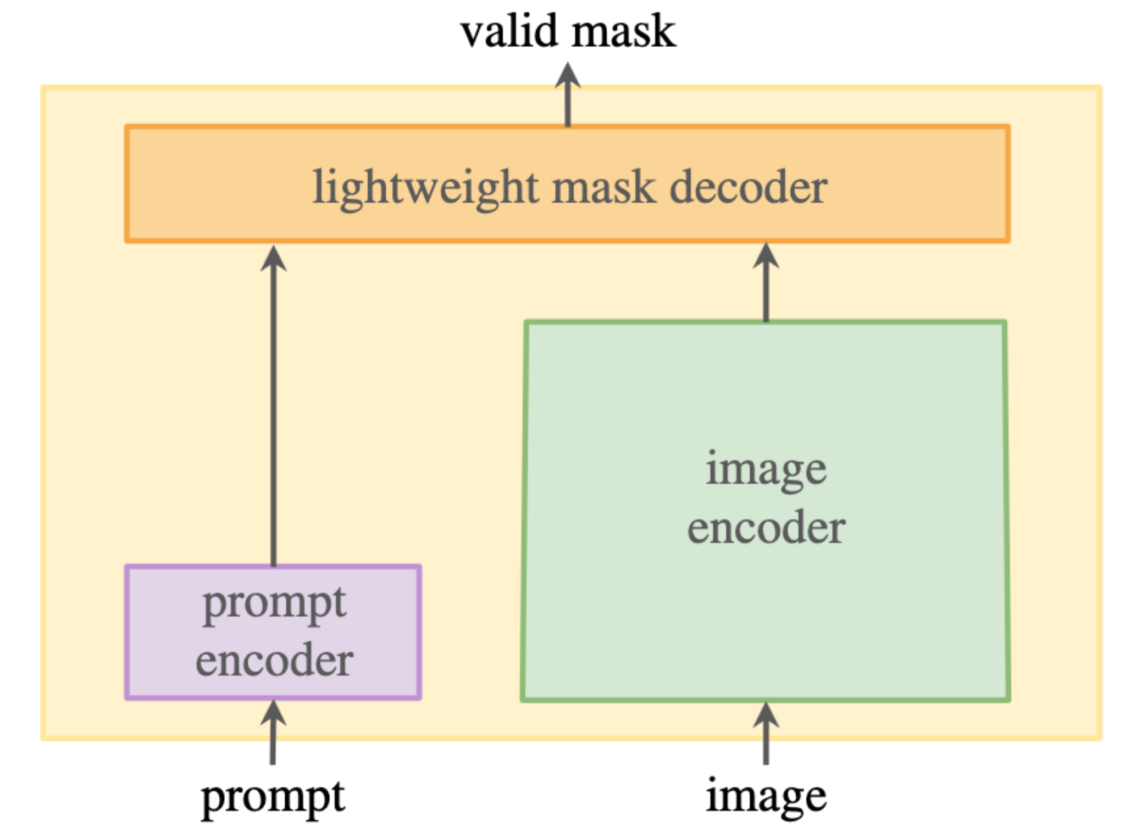
Segment Anything
Task
Model
Data

Slide 6
Task
A promptable segmentation task
Prompts in multiple formats
Zero-shot generalization to new tasks
As a component of a larger system
Edge detection
Instance segmentation
Text-to-masks
Natural pre-training task
Generate prompts from annotation

Slide 7
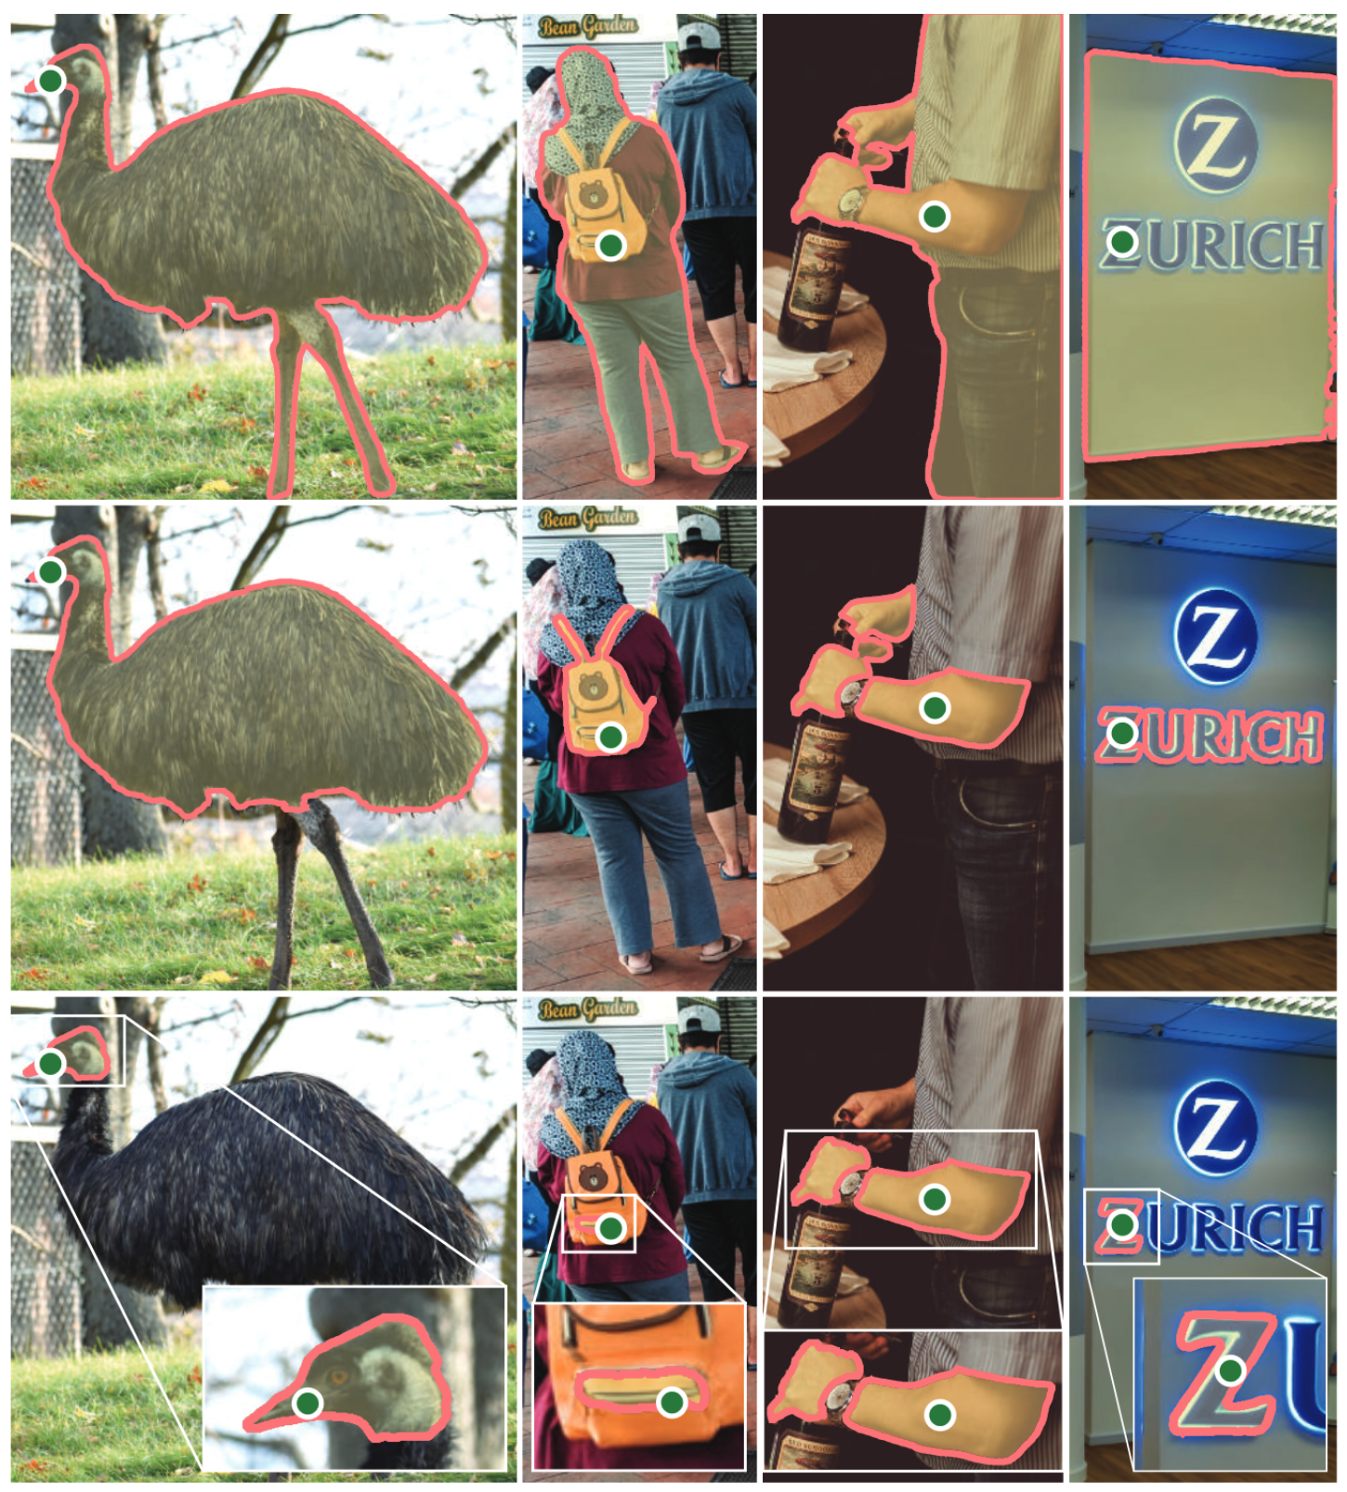
Task
Prompt ambiguity
Prompts can be ambiguous
Part vs Whole
Predict valid masks

Slide 8
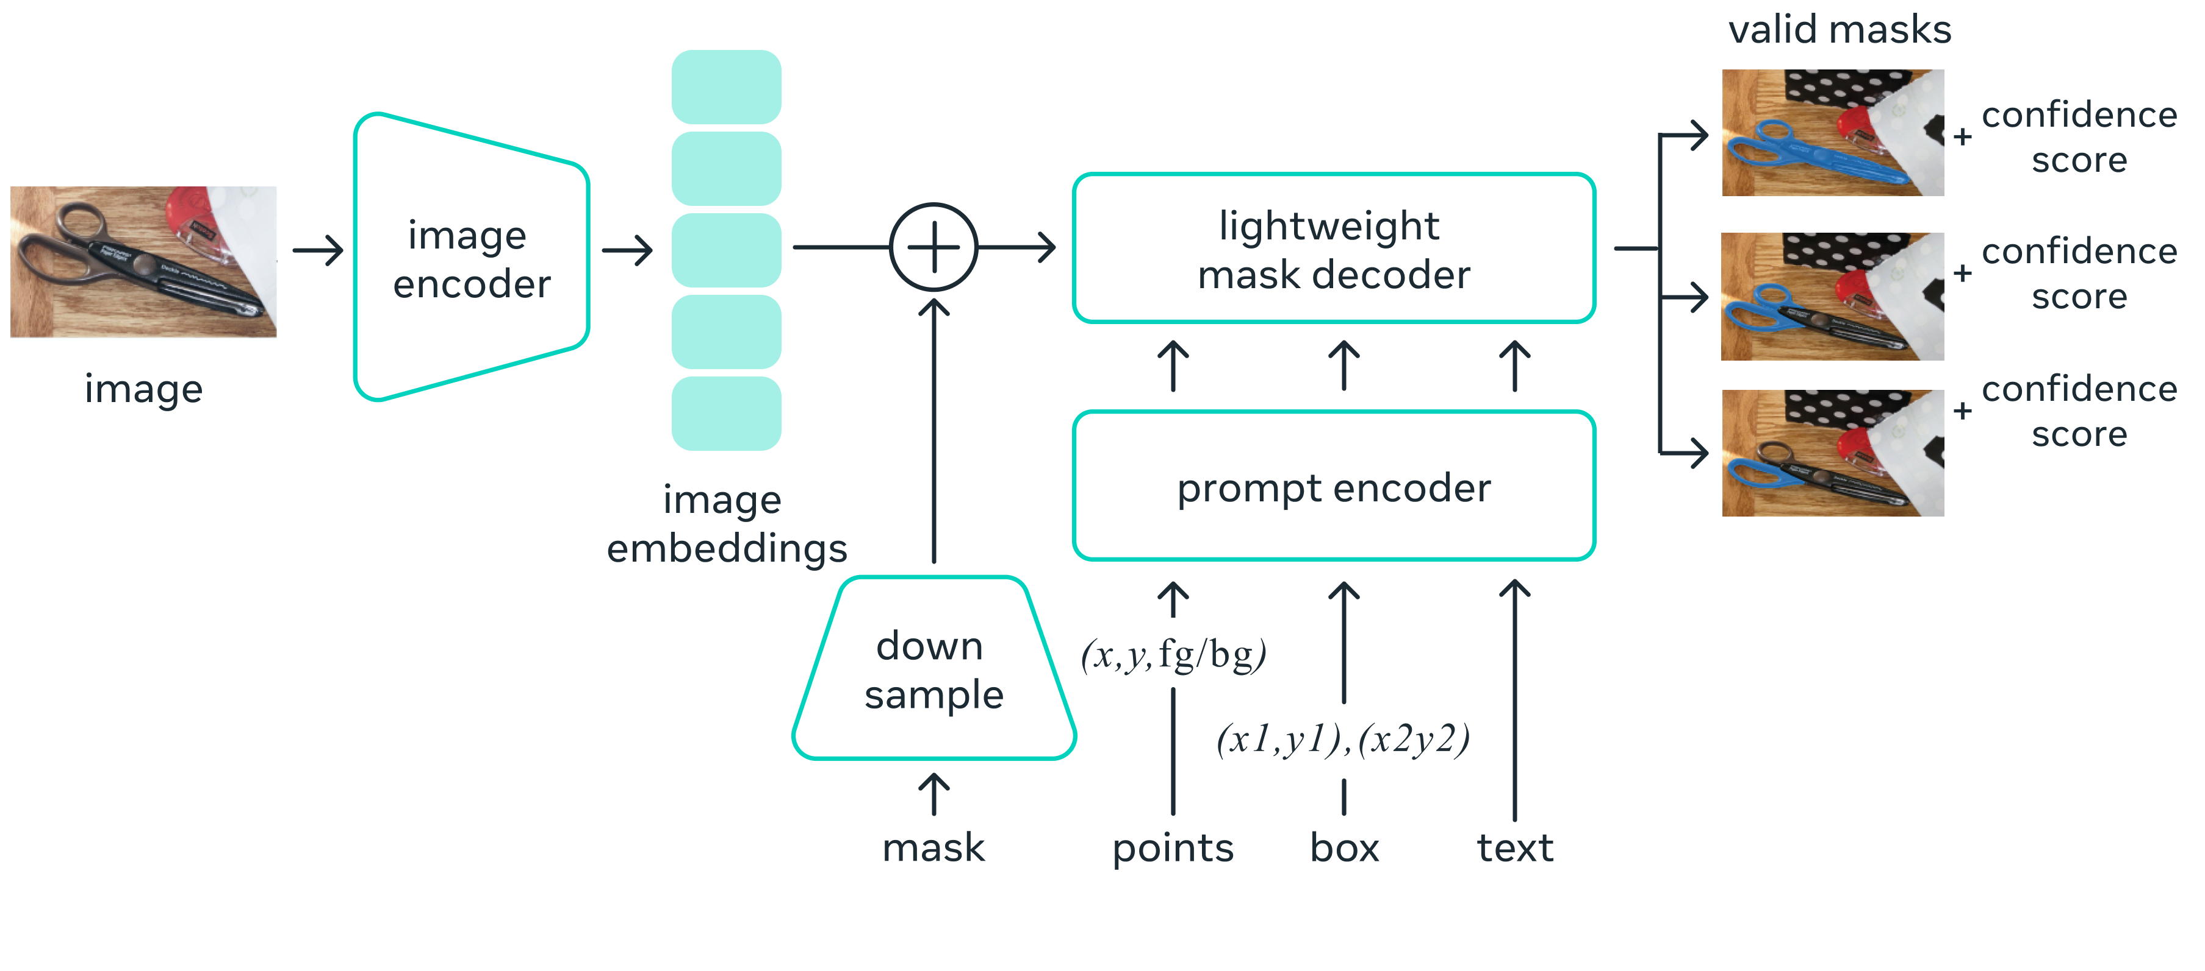
Model - SAM
Similar to MaskFormer
A model suitable for the task
Element-wise convolution
MAE pre-trained ViT
Reuse image embeddings across multiple queries
Predict 3 valid masks
Score ≈ IoU
Encode prompts

Slide 9
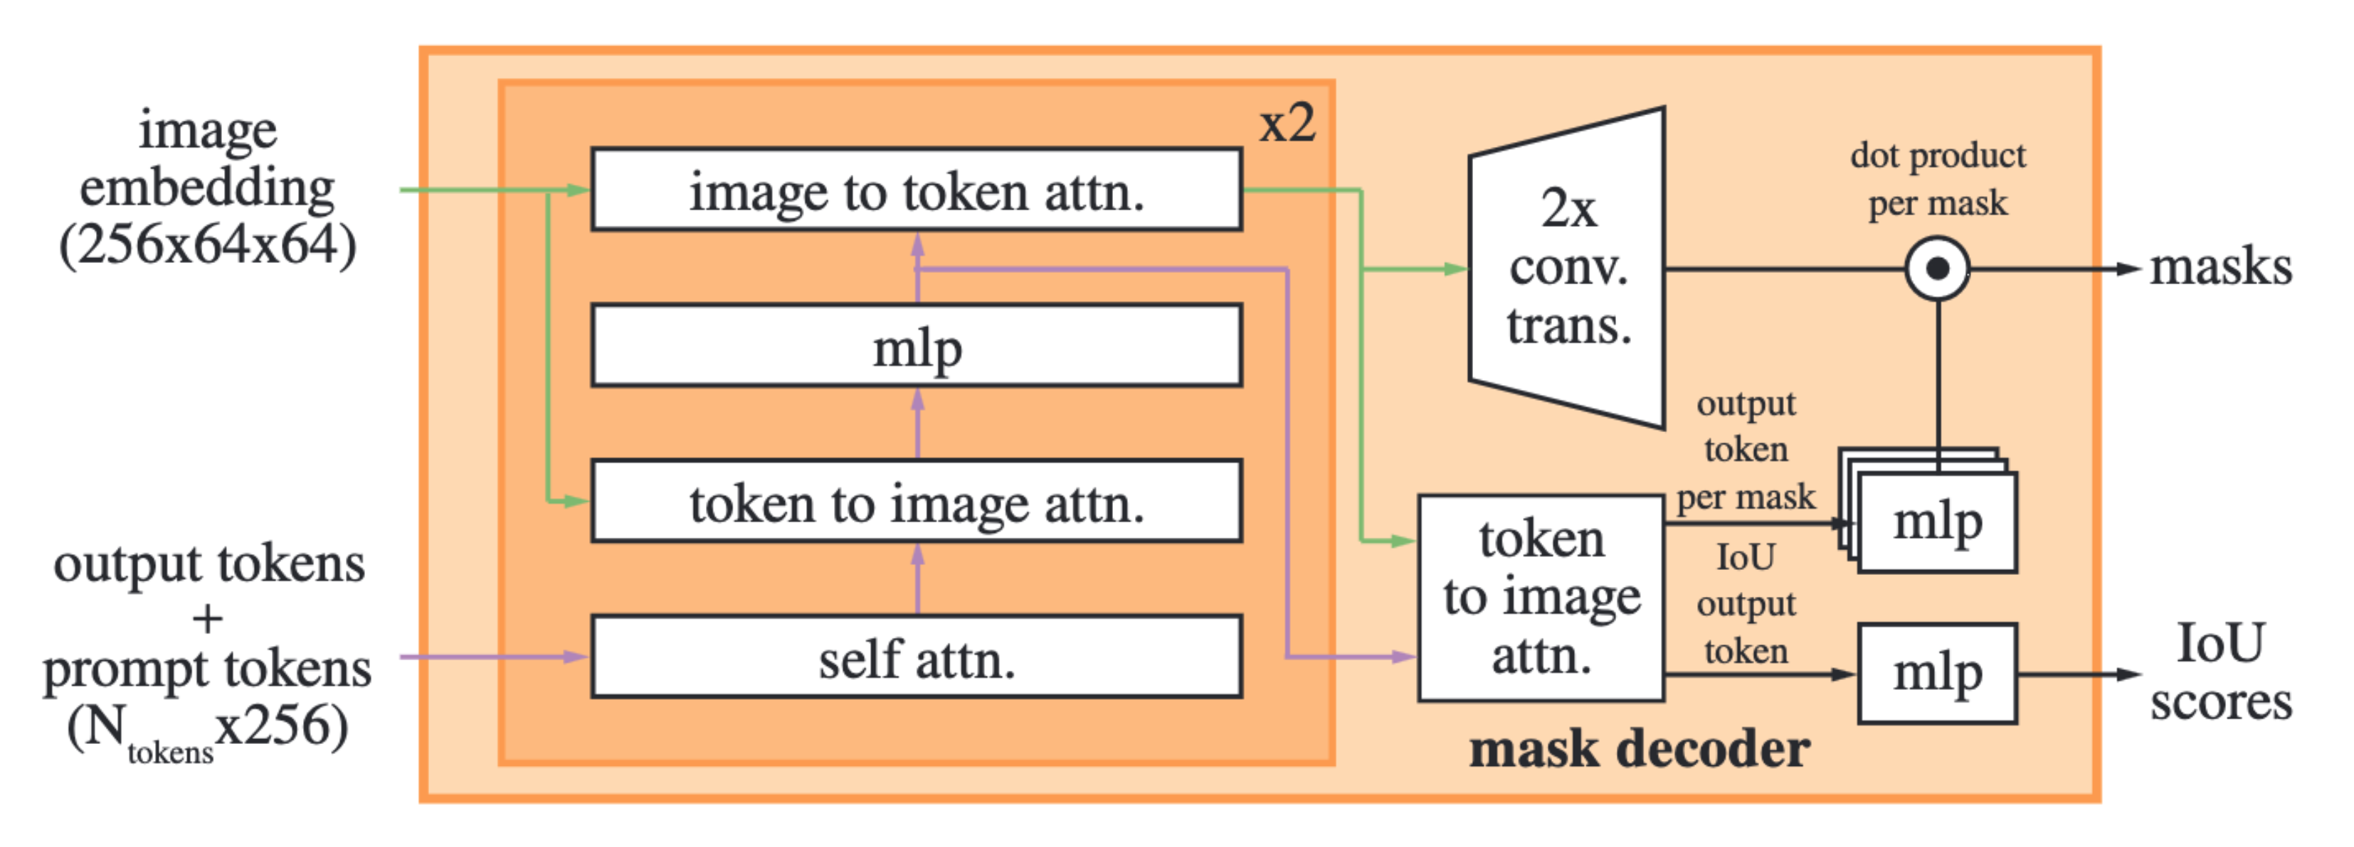
Model - SAM
Mask decoder

Slide 10
Data
Data engine to power SAM
There is not a lot of mask data
Assisted-manual stage
Train on public mask dataset
Annotation tool powered by SAM
6 retraining
4.3M masks from 120k images
Semi-automatic stage
Increase diversity
Manual annotation of unannotated objects
5 retraining
10.2M masks from 180k images
Fully automatic stage
Enough masks
Ambiguity-aware model + confidence
Stable masks + NMS + Zoom-in
1.1B masks from 11M images

Slide 11
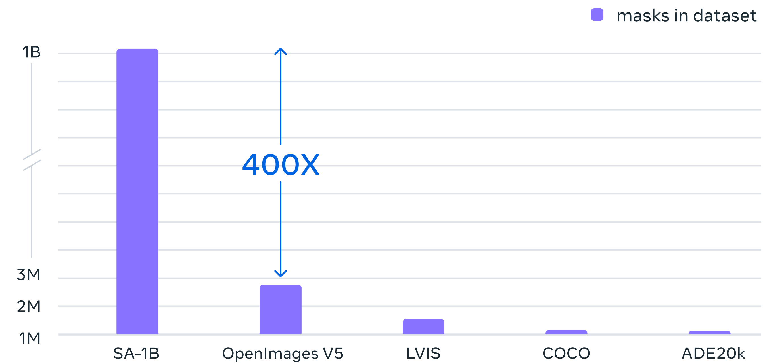
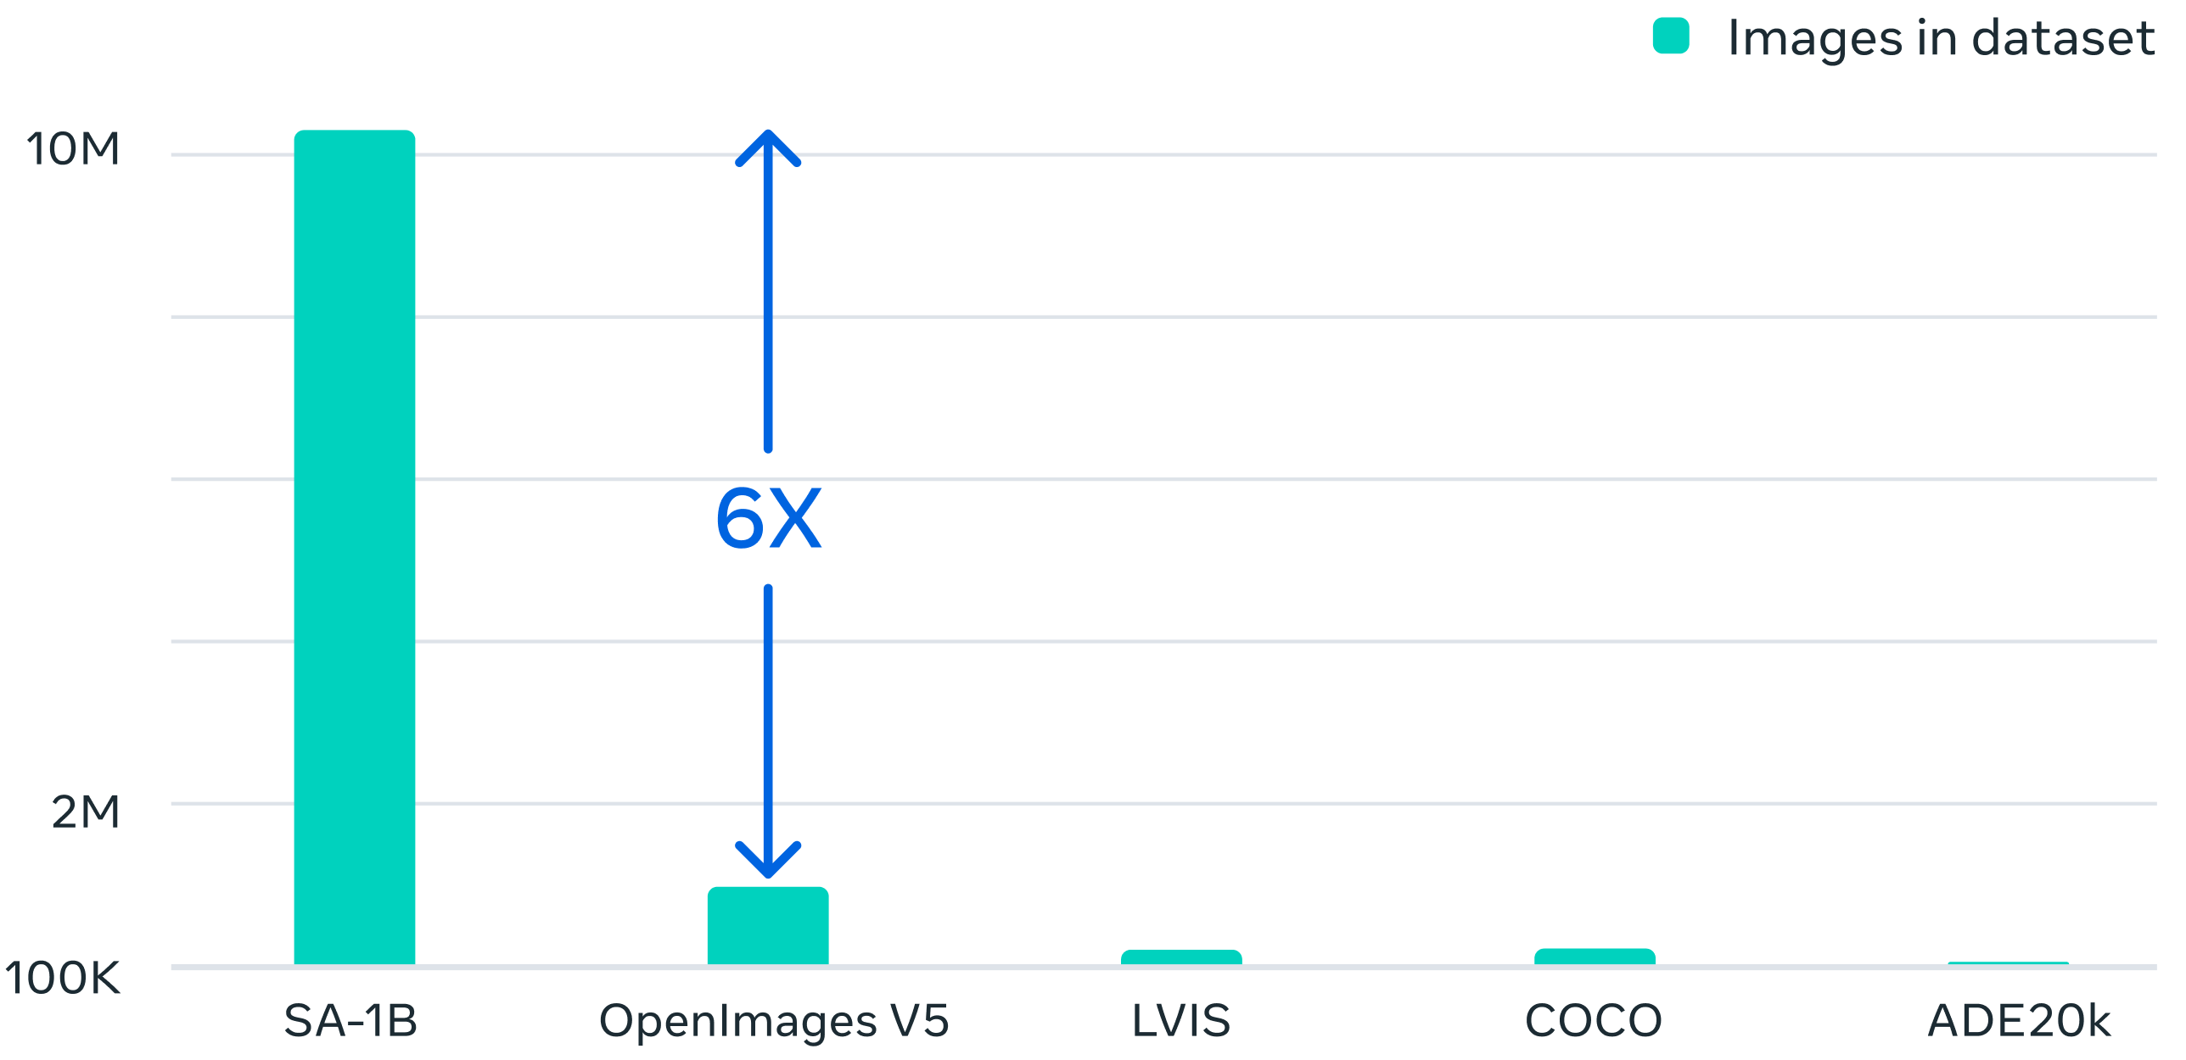
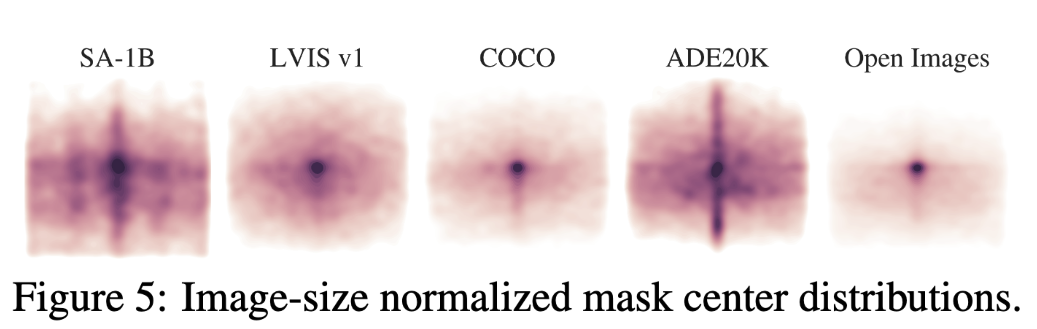
SA-1B
A large masks dataset

Slide 12
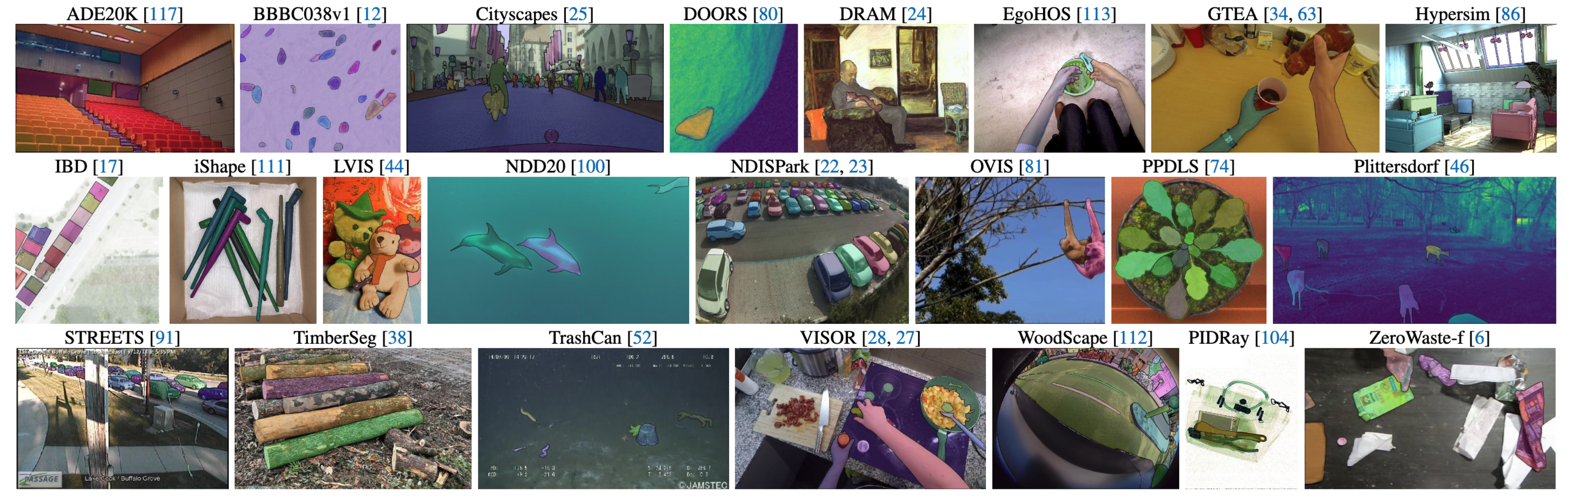
Zero-Shot Transfer Experiments
Test on 23 diverse datasets

Slide 13
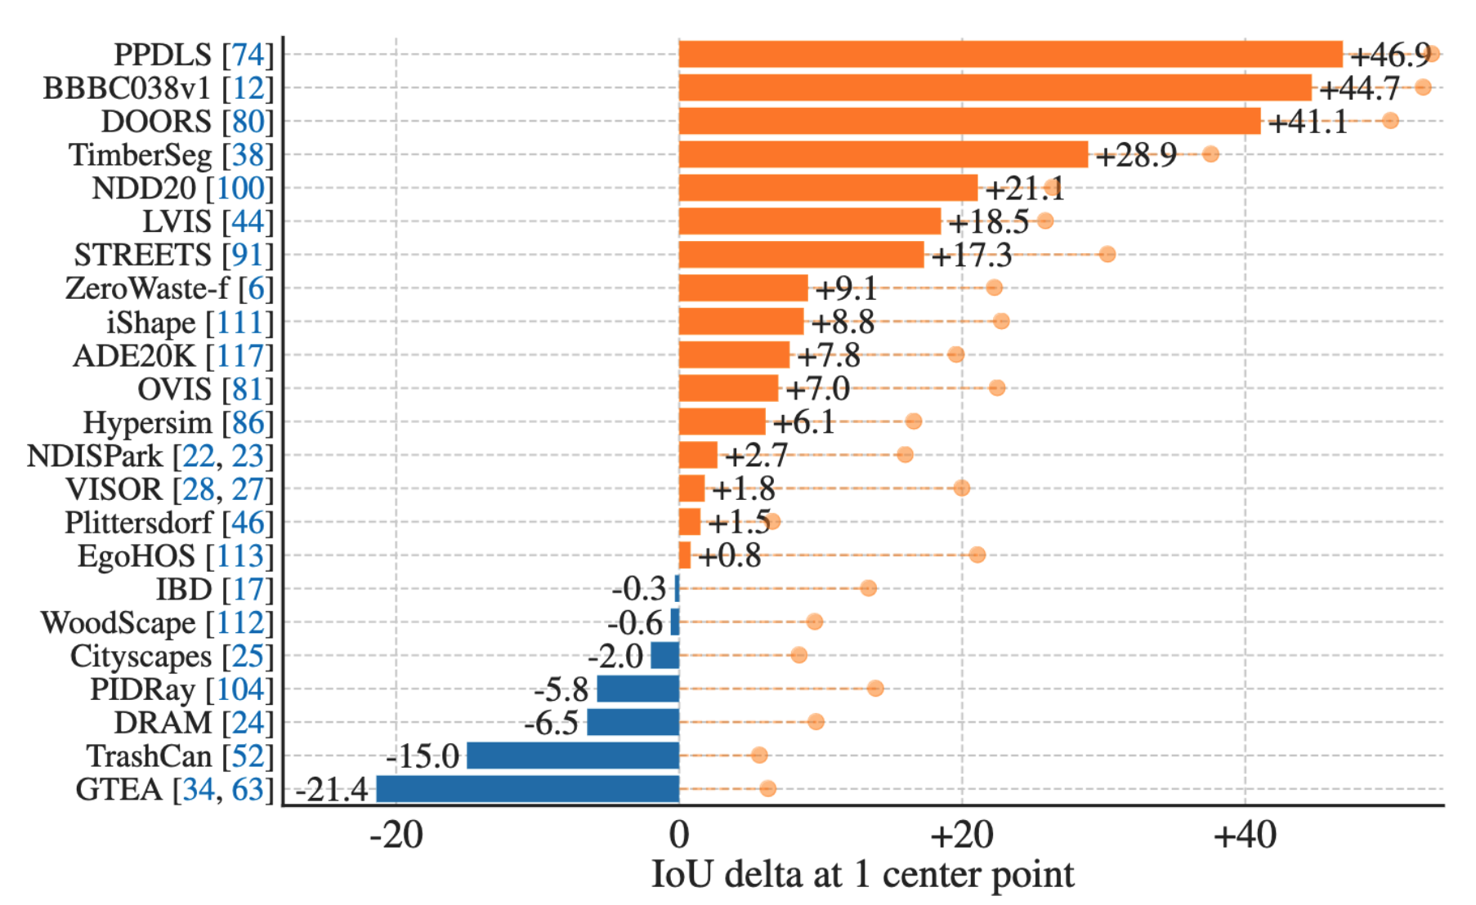
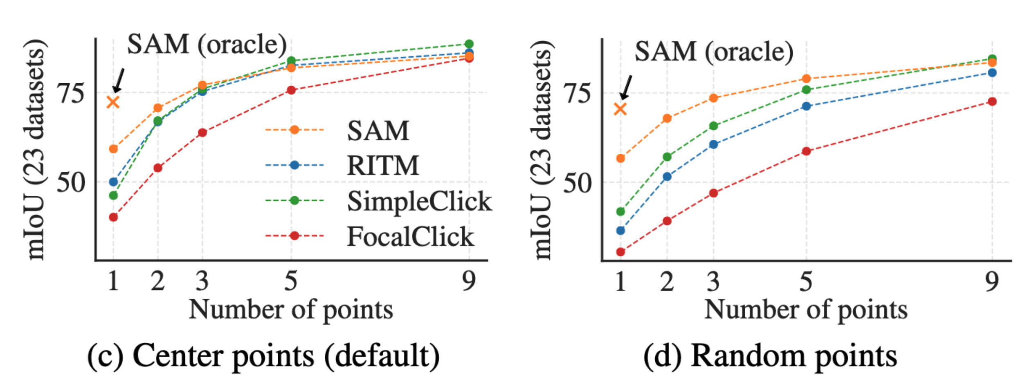
Zero-Shot Transfer Experiments
Results

Slide 14
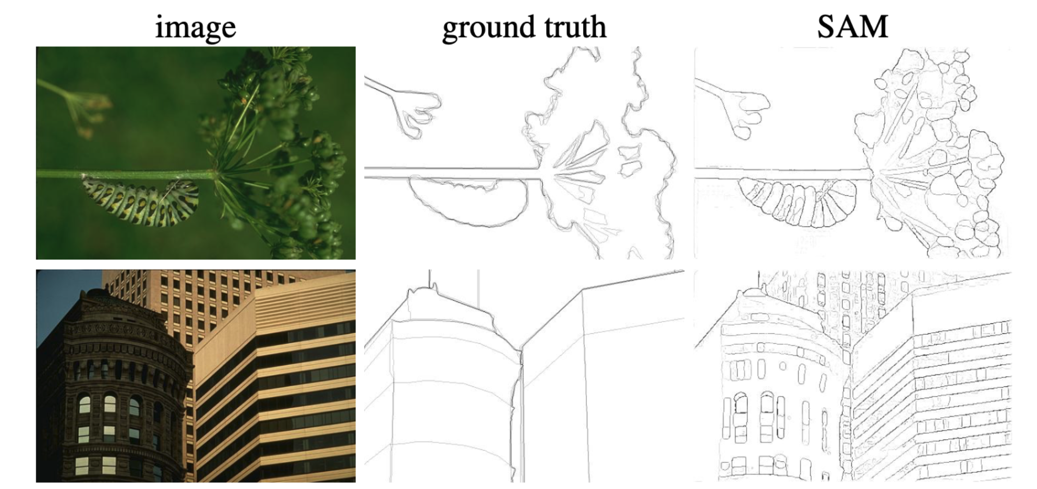
Zero-Shot on Other Tasks
Edge detection
Masks generation
NMS
Sobel filter on unthresholded mask

Slide 15
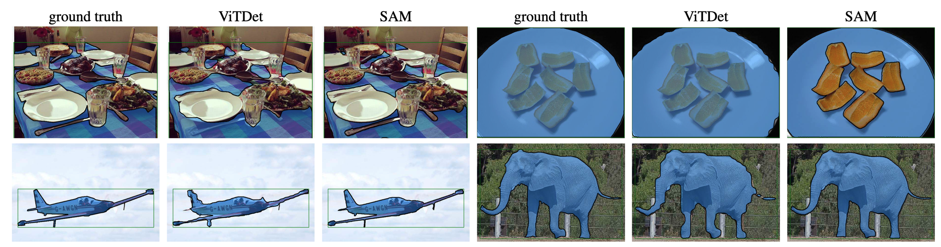
Zero-Shot on Other Tasks
Instance segmentation
Object detector bounding boxes → SAM

Slide 16
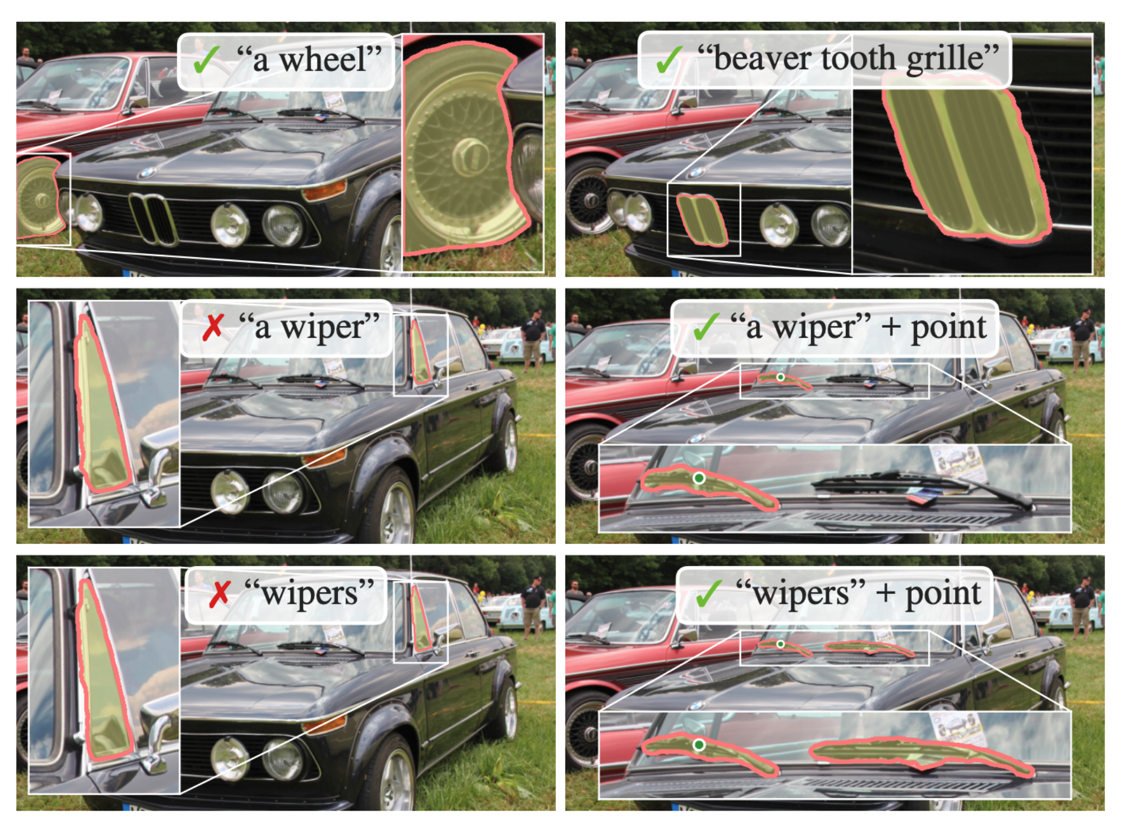
Zero-Shot on Other Tasks
Text-to-masks
CLIP image embeddings during training
CLIP text embeddings at inference
Point help solve ambiguity

Slide 17
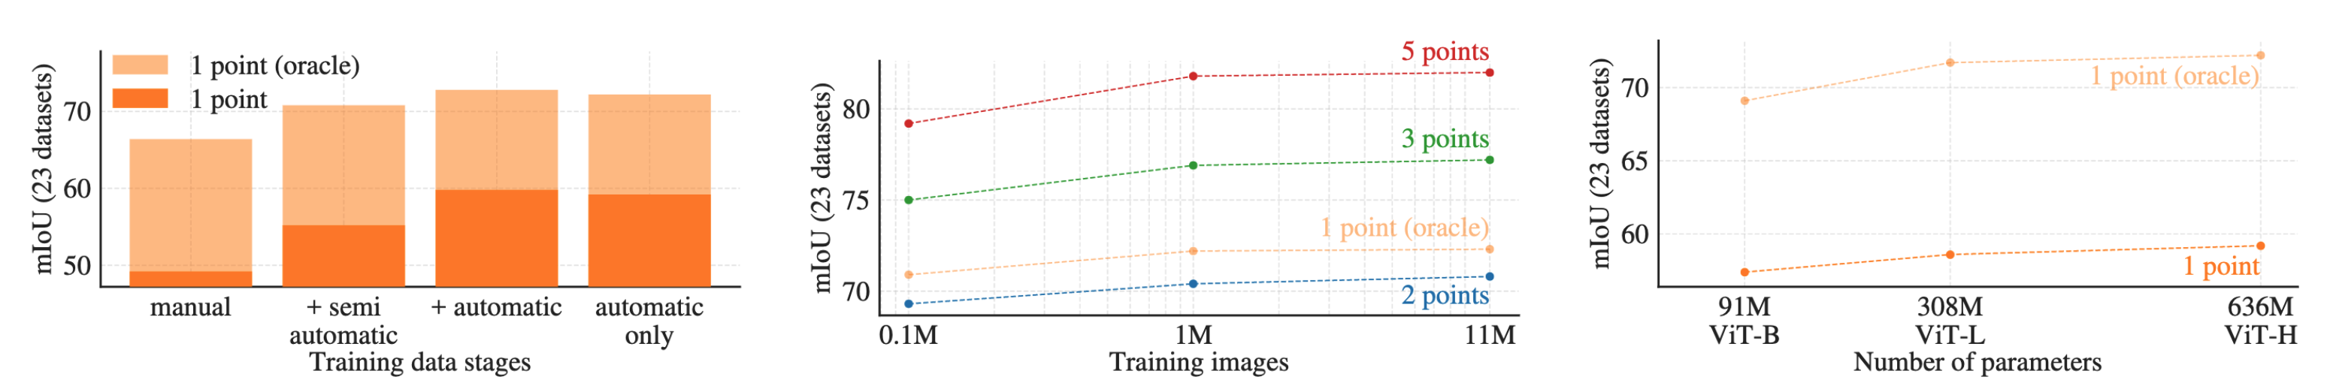
Ablations
Oversampling by 10x manual and semi-automatic data
Stages help to better handle ambiguity
10% of SA-1B comparable to 100%
Saturated scaling with bigger architectures

Slide 18
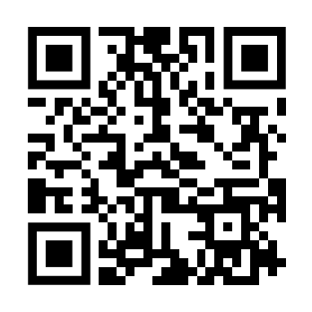
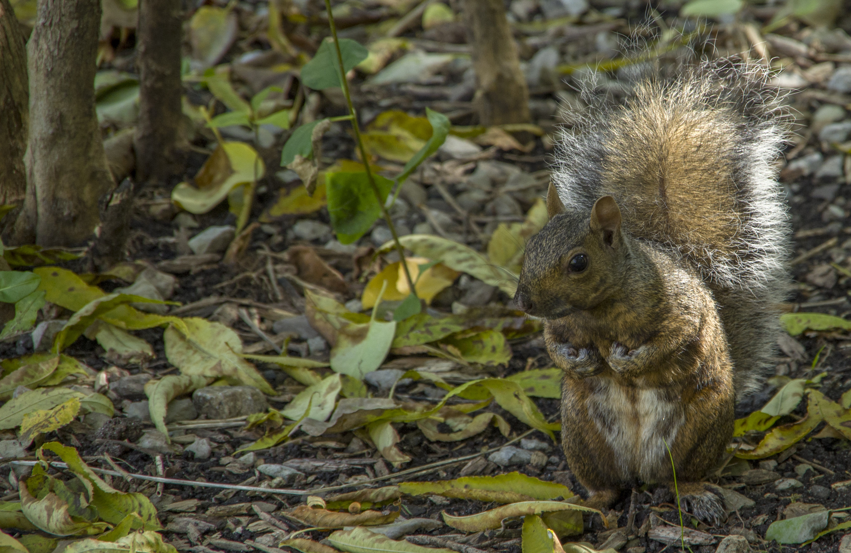
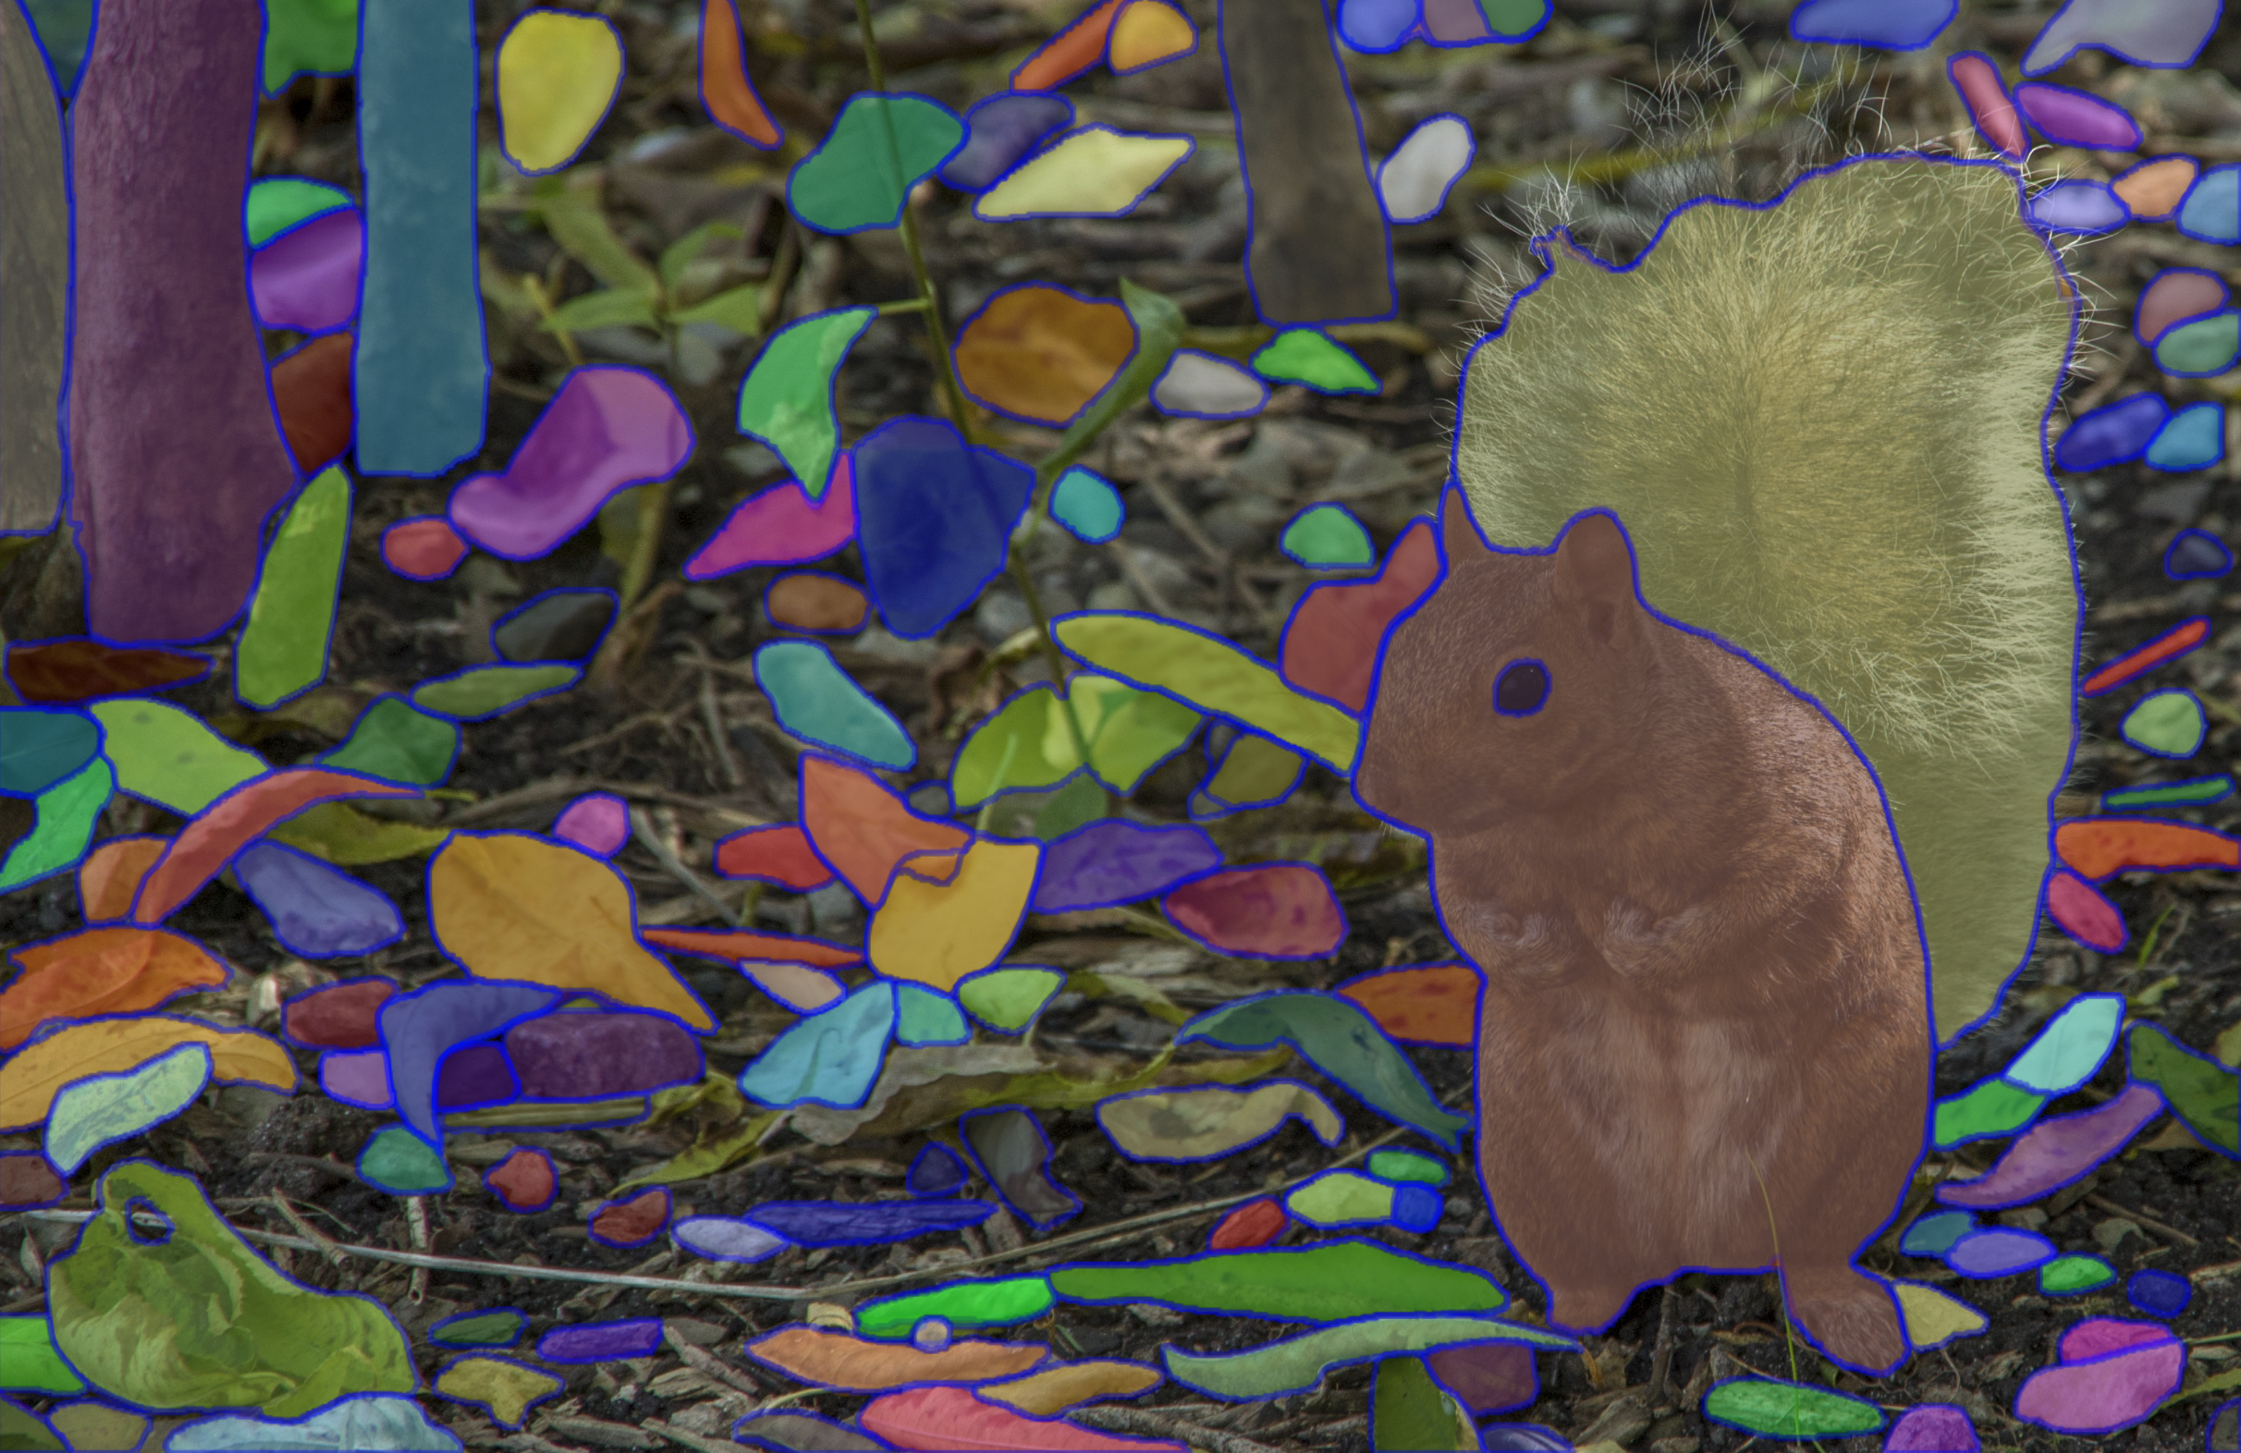
Try it on your own pictures
https://segment-anything.com/demo

Slide 19
Questions?

Slide 20
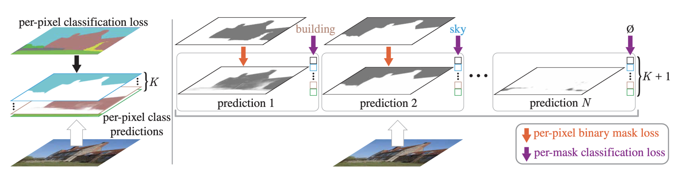
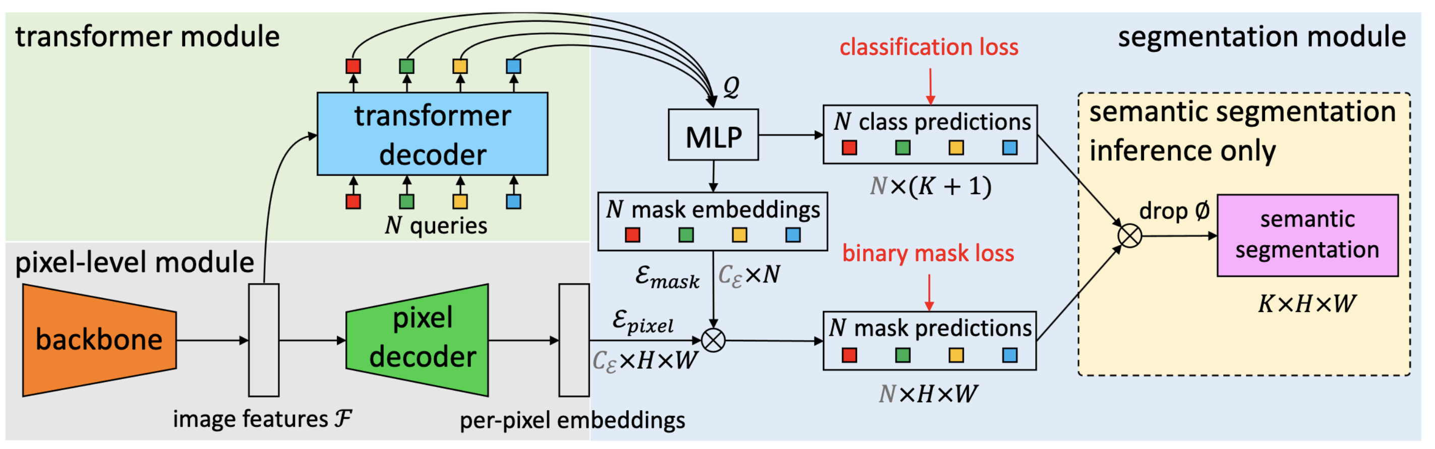

Slide 21
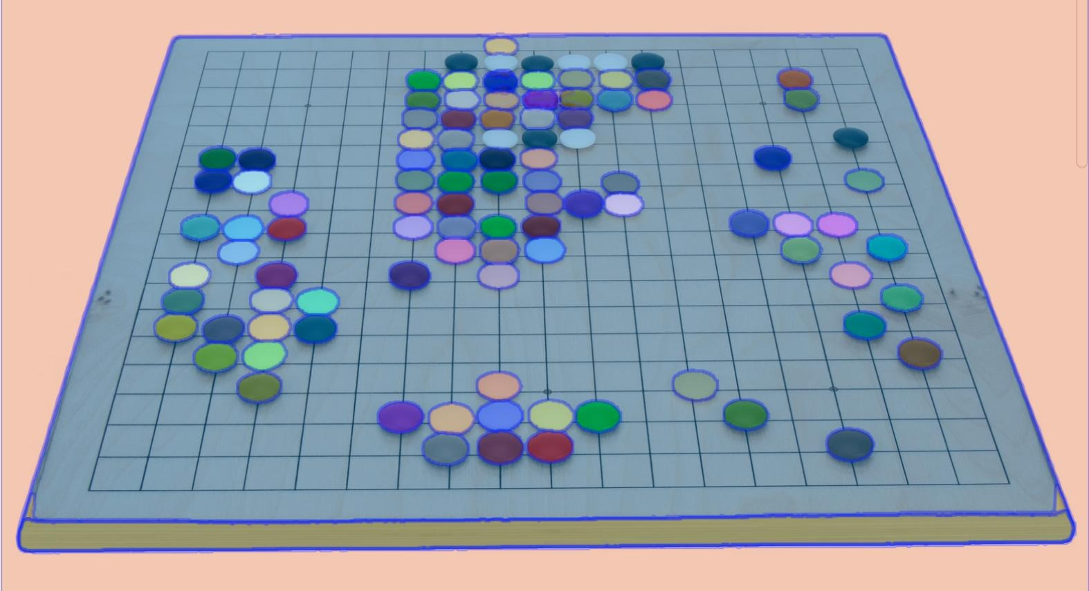
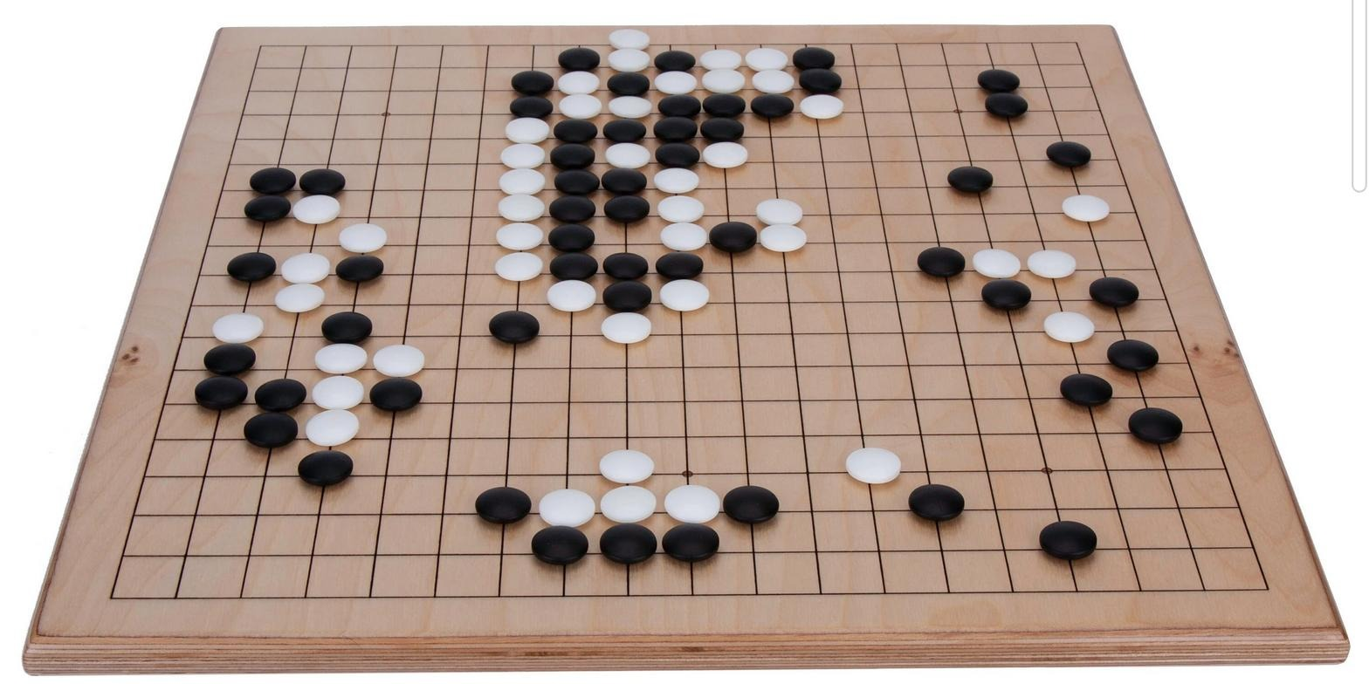
Try it on your pictures
https://segment-anything.com/demo
Src: https://www.etsy.com/ca/listing/1010337560/solid-hardwood-go-and-go-moku-board

Slide 22
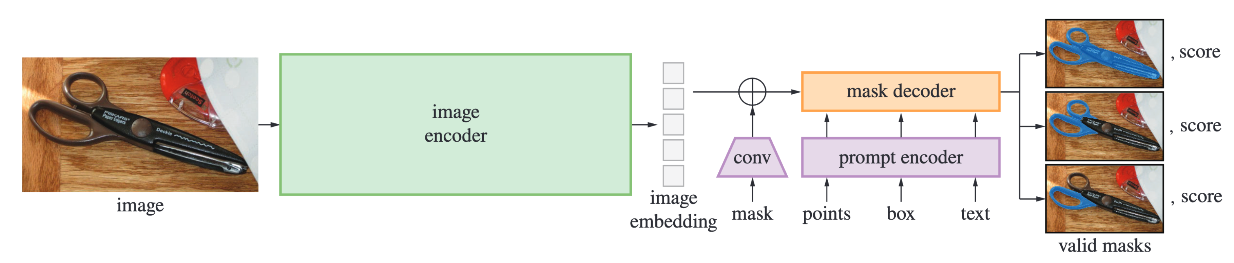
Model - SAM
A model suitable for the task
Image encoder
MAE pre-trained ViT
Reuse image embeddings across multiple queries
Prompt encoder
Box, Points → Positional encoding
Learned embedding for type
Text → CLIP
Masks → Element-wise convolution into the embeddings

Slide 23
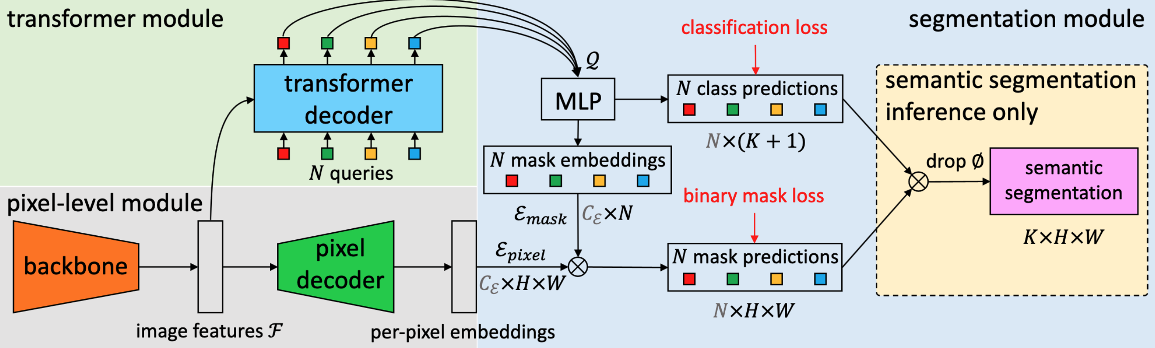
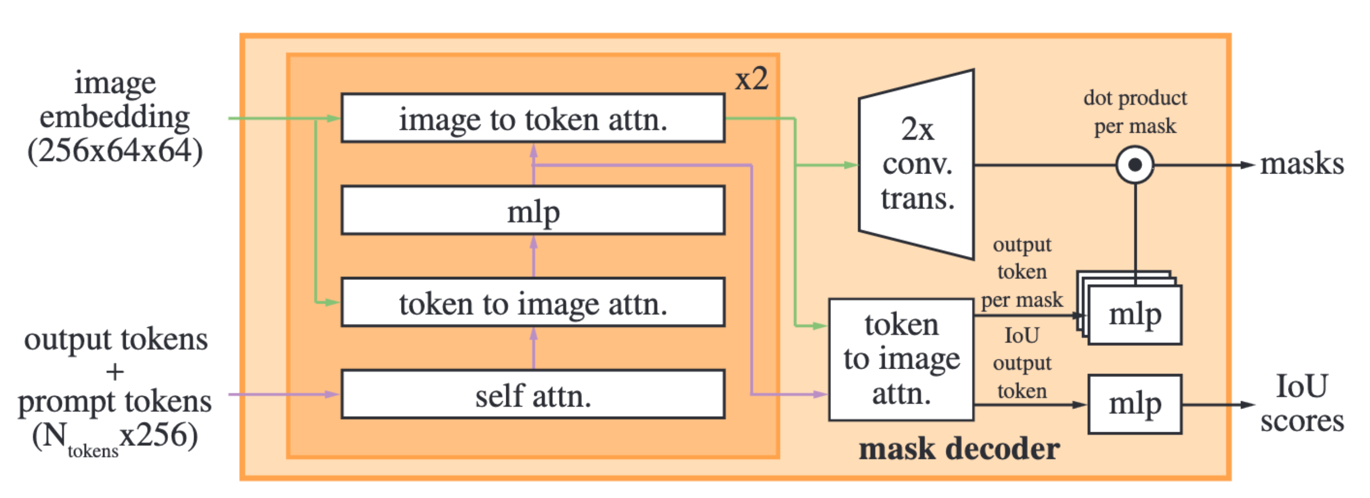
Model - SAM
A model suitable for the task
Mask decoder
Inspired by MaskFormer (Cheng et al., NeurIPS 2021)
Predict 3 masks for ambiguity
Score → estimated IoU

